Slide 1
1.3 Introduction to HTML Forms and Servlets
1.3.1 Working with HTML Forms
1.3.2 Servlets, HTTP Connections,
Server Push–Client Pull, and Refresh
1.3.3 Using Forms with Servlets
Yang Liu

Slide 2
1.3.1 Working with HTML Forms
The Need for Dynamic Content
The FORM Element
Form Controls
Form Control Elements
Form Design
Resources
Yang Liu

Slide 3
The Need for Dynamic Content
So far we have seen HTML primarily only in its role as a markup language—a tool that allows us to format and present content to users who view it with Web browsers.
However, Several factors might complicate things and make meeting user needs with ready-made, static pages intractable. Sometimes, the needs of our users may outstrip our ability to meet them.
Yang Liu

Slide 4
Example
Example
  The content on our pages changes frequently.
  http://www.csu.edu.cn
  Our users need the content we supply to be combined with information they supply.
  http://mail.csu.edu.cn
How to resolve these problems?
Form (client-side), Servlet (server-side)
Yang Liu

Slide 5
Are Dynamic Web Page?
GIF Image
JavaScript dynamic effect
Multimedia effect
../Examples/HTML/IsADynamicPage.html
Are those dynamic webpages? Why?
How to design dynamic webpages?
Form (client-side), Servlet (server-side)
Yang Liu

Slide 6
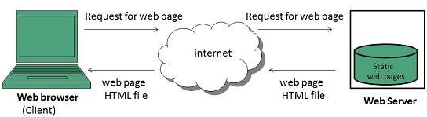
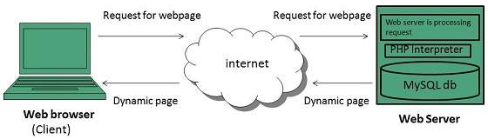
Dynamic/Static Webpage
Yang Liu

Slide 7
Dynamic / Static Web Page
动态网面与静态网面区别
  页面HTML代码不变，但是页面的内容和显示效果可以随着时间、环境或者数据库操作的结果而发生改变。
  动态网页能与后台数据库交互与数据传递。即：网页 URL后缀不是.htm、.html、.shtml、.xml等静态网页形式，而是以.aspx、
  .asp、.jsp、.php、.perl、.cgi的形式，且有标志性符号——“?”。
动态网面特点
    利用数据库技术，动态网页更新和维护相对容易
    动态页面交互性强，可以实现更多网页功能
    响应速度相对于静态页面慢，涉及到数据库访问等过程
Yang Liu

Slide 8
The FORM Element
Form is client-side of solution to dynamic content
HTML表单: 用于搜集不同类型的用户输入。
A FORM element can contain, in addition to the usual page content, markup tags, and special elements known as controls or widgets.
FORM element
Some important control elements can be contained in FORM element.
Yang Liu

Slide 9
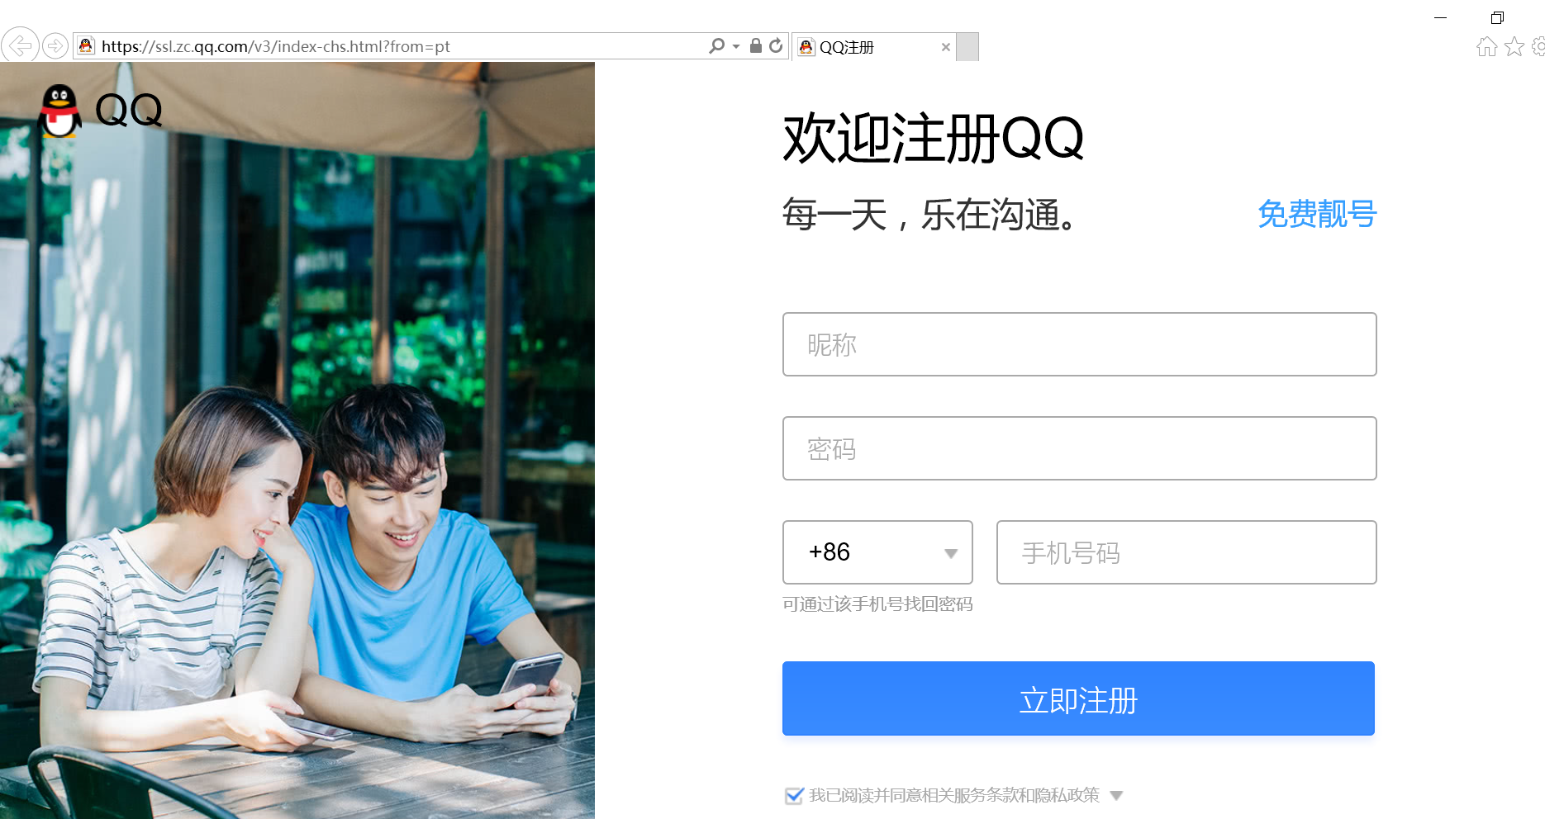
https://ssl.zc.qq.com/v3/index-chs.html?from=pt
Yang Liu

Slide 10
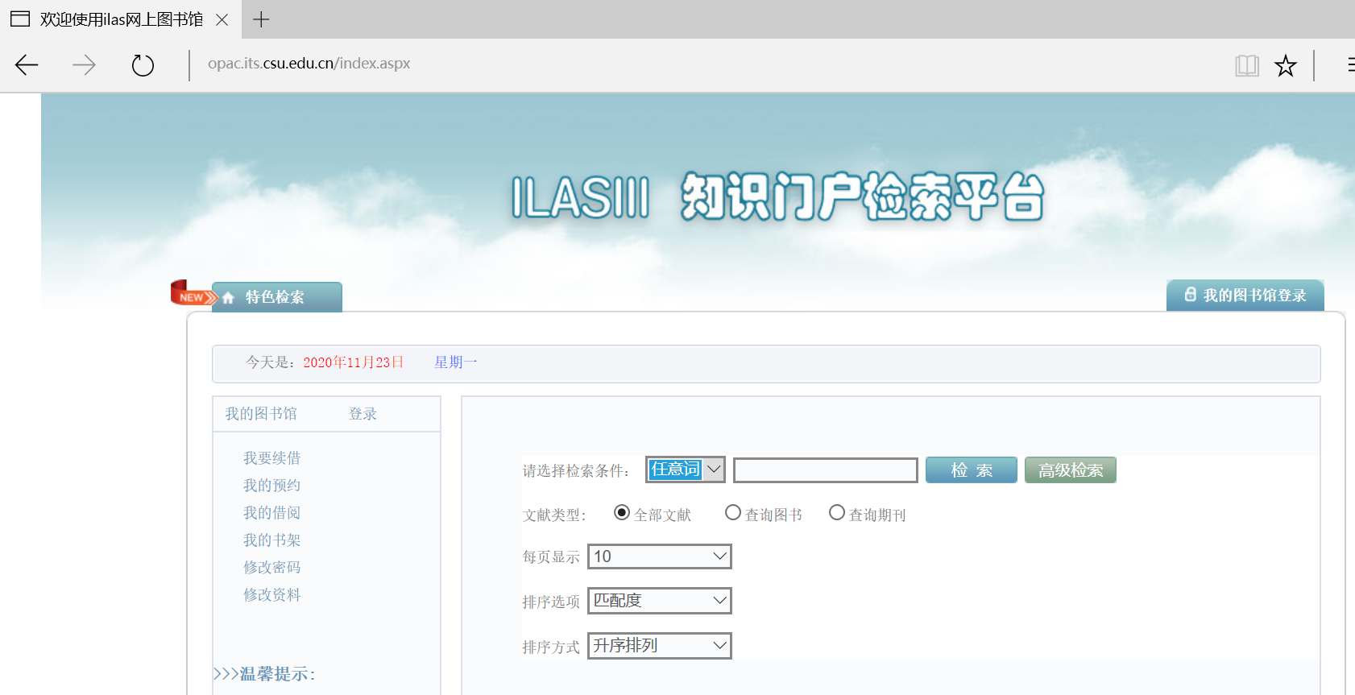
http://opac.its.csu.edu.cn/index.aspx
Yang Liu

Slide 11
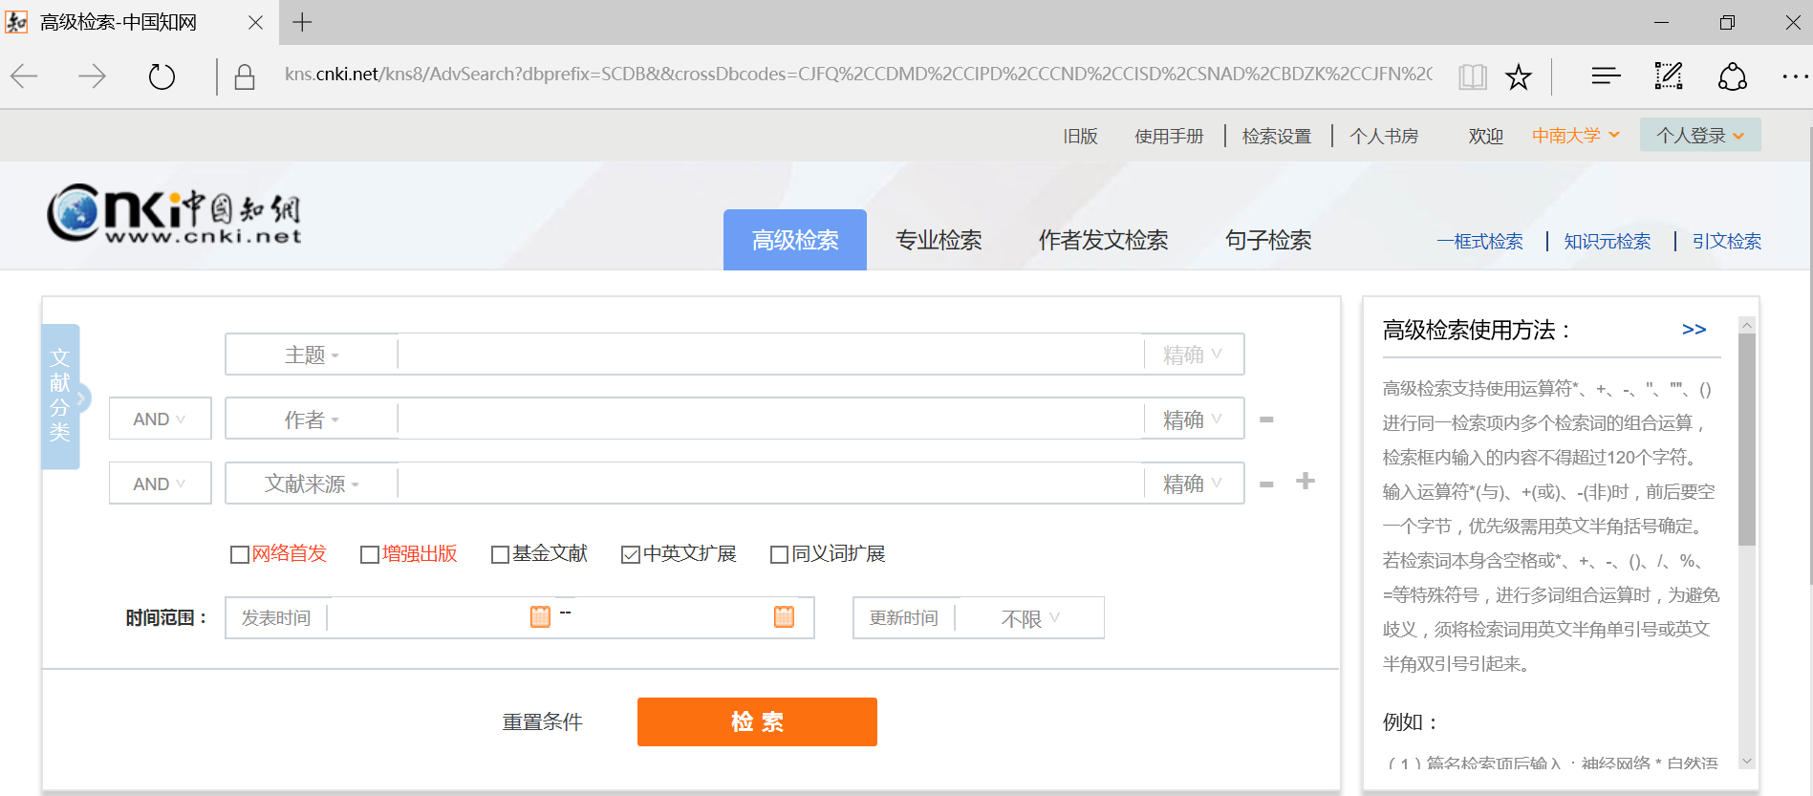
https://kns.cnki.net/kns8/AdvSearch?dbprefix=SCDB&&crossDbcodes=CJFQ%2CCDMD%2CCIPD%2CCCND%2CCISD%2CSNAD%2CBDZK%2CCJFN%2CCCJD
Yang Liu

Slide 12
FORM Element
action, method, enctype, accept, name, title……
<FORM element attributes >
form content ...
</FORM>
Yang Liu

Slide 13
FORM Element
Attributes
  Action
    The action attribute designates the program that will process the form data.
  Method
    The method attribute specifies the HTTP method by which the data will be sent to the server.
Yang Liu

Slide 14
FORM Element
<FORM action='http://example.com/servlts/myprog'
method='post'>
form content ...
/FORM>
Provides the name of the program that will process the form data
has only two valid options—post and get
Yang Liu

Slide 15
Other Attributes
Other attributes
  Name： name of the form
  Enctype : encode type of form data
  (default：url-encoded)
  Target: _self, _blank, _parent, _top
  …
Yang Liu

Slide 16
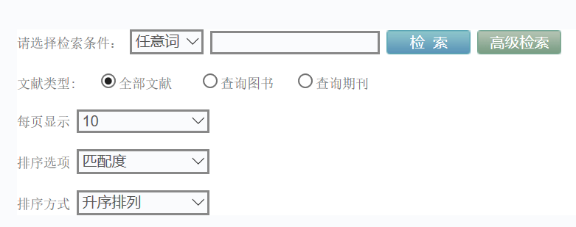
Form Controls
Label: used to specify label text for form controls
Input: used for special purpose user input
Buttons: push button, reset button, submit button
Yang Liu

Slide 17
Label Element
source
<label> 姓名： <input type=‘text’ name=‘username’ > </label>
<label for=‘username’>姓名：</label> <input type=‘text’ name=‘username’ id=‘username’>
Yang Liu

Slide 18


Form Controls
Button
  Three types of buttons: push button, reset buttons, and submit buttons
Checkbox
  Checkbox controls allow users to toggle them “on” and “off”
Radio buttons
  A radio button group is created by assigning all of the radio buttons that are to be in the group the same control name.
Label
  Label controls are used to specify label text for form controls.
Yang Liu

Slide 19
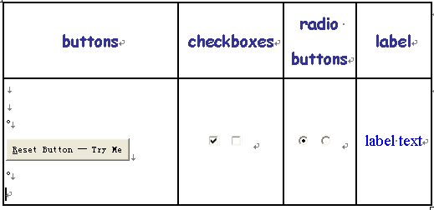
Form Controls
Yang Liu

Slide 20
Form Controls
Menu
  Allow users to choose from set of predetermined options.
  Three types: single-option drop-down lists, scrollable-option list, and grouped-option drop-down list.
Text input controls
  Allow users to input text.
  Three types: one for single-line input, one for multiple-line input, and one for text that should not be displayed as it is being typed.
Yang Liu

Slide 21
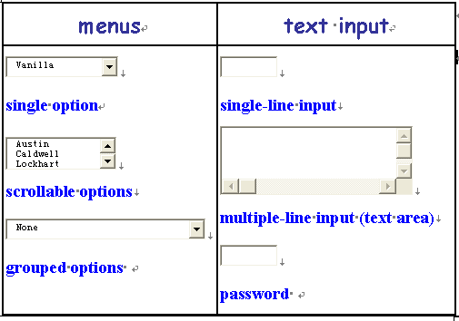
Form Controls
Yang Liu

Slide 22


Form Controls
File select
  File select controls allow users to browse to files, select files, and submit the contents of a file or files with a form.
Image Controls
  Image controls are submit buttons
Yang Liu

Slide 23
Quick facts about controls
Each control has a control name, which is designated by its name attribute.
All controls can have both an initial value and a current value.
When a form is submitted for processing, the controls that have values have their names and values combined into name-value pairs, which are then submitted to a server with the form.
Yang Liu

Slide 24
Form Control Elements
The number of form elements used to create these controls is somewhat smaller.
Some elements can create more than one type of control.
In fact, the all-purpose INPUT element can be used to create all but the more special-purpose controls—such as menu controls.
Yang Liu

Slide 25
The Input Element
Attributes
  Name and value
  Type
  Attributes that limit a control's input. (checked, disabled, size, maxlength)
  Tabindex, accesskey
  …
<INPUT element attributes>
Yang Liu

Slide 26



Type
Text and Password
rendered control | source
 | <input type='text' name='txtline1'>
 | <input name='txtline2'>
 | <input type='text' name='txtline3' value=‘default value‘ size='120' maxlength='200'>
 | <input type='password' name=‘pwd' size='8' maxlength='8'>
Yang Liu

Slide 27
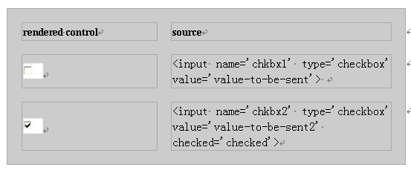
Type
CheckBox
checkbox types must include a value attribute.
Yang Liu

Slide 28
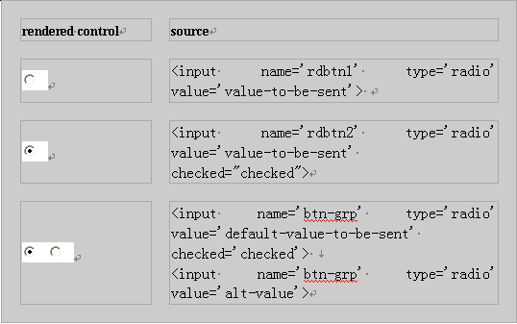
Type
radiobox types must include a value attribute.
Radio
Yang Liu

Slide 29
Type
Checkbox & Radio both must include a value attribute.
Radio buttons differ from checkboxes
  Radio butoons are commonly used in groups in which only one button can be selected at a time.
  INPUT controls of type radio are made into a group by assigning each control that is to be in the group the same value for its name attribute.
Yang Liu

Slide 30
Type
File
Rendered control
source | <input name='selct-a-file' type='file'>
Yang Liu

Slide 31


Type
Submit and Image
Rendered control | source | source for the equivalent button using the BUTTON element
 | <input type='submit' name='subbtn'> | <BUTTON name='subbtn' value='submit' type='submit'>Submit Query</BUTTON>
 | <input name='subbtn2' type='submit' value='Submit Answer'> | <BUTTON name='subbtn2' value='submit' type='submit'>Submit Answer</BUTTON>
Yang Liu

Slide 32

Type
Rendered control | source | source for the equivalent button using the BUTTON element
 | <input name='subbtn3' type='submit' value='Log On'> | <BUTTON name='subbtn3' value='LogOn' type='submit'>Log On</BUTTON>
 | <input name='graphicsubbtn' type='image' src='tools.gif' alt='Submit Tools Information Form'> | <BUTTON name='graphicsubbtn' type='submit'><IMG src='tools.gif' alt='Submit Tools Information Form'></BUTTON>
Yang Liu

Slide 33

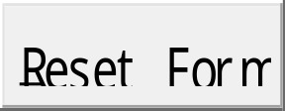
Type
Reset
Rendered control | source
 | <input name='resetbtn' type='reset'>
 | <input name='resetbtn2' type='reset' value='Reset Form'>
Yang Liu

Slide 34
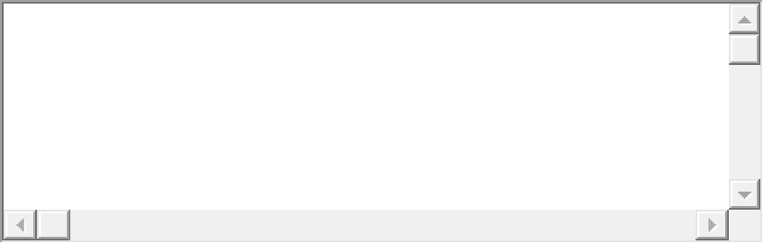
TextArea Element
Rendered control
source | <TEXTAREA name='textarea' cols='40' rows='5'></TEXTAREA>
Yang Liu

Slide 35
Form Design :
Taking Users into Consideration
How should we place controls onto our forms?
  logically
  labeled clearly
  in an order that they find to easy to work with
  …
Yang Liu

Slide 36
Control Attributes
Some form control attributes are designed to help us for designing the controls.
  readonly
  tabindex
  accesskey
  alt
TABLE element can also help us to place controls where we want.
  http://wdvl.com/Authoring/HTML/4/Tags/forms.html
Yang Liu

Slide 37
Further Study
Some other form elements
  Button
  Select
  Filedest
  …
Yang Liu

Slide 38
Resources
FORM element
Web Developers Virtual Library (WDVL)
Tag Reference
Yang Liu

Slide 39
1.3.2 Servlets, HTTP Connections, Server Push–Client Pull, and Refresh
An Overview of Servlets
HTTP Connections and Connection Life Cycle
Server Push–Client Pull
Refresh
Two Client-Pull Demos
Yang Liu

Slide 40
An Overview of Servlets
Servlet is server-side of solution to dynamic content.
Servlets are programs that run inside of complex software programs known as Web servers (hereafter referred to as "servers").
It is the servers that run servlets, in order to construct dynamic responses to client requests.
Although servlets respond to requests from clients, servlets do so indirectly—at the request of a server, not the client itself.
Yang Liu

Slide 41
Servlets
The servlet will continue to run, awaiting a subsequent request. In fact, a servlet will continue to run indefinitely, though it can be terminated as a part of system housekeeping.
Yang Liu

Slide 42
HTTP Connections and Connection Life Cycle
The HTTP connection life cycle typically follows this pattern:
  an HTTP connection is opened
  a client sends a request to a server
  the server sends a response to the client
  the connection is closed
  If the client then sends subsequent requests to the server, the same pattern holds
For each request, a connection is opened, the request is sent, a response is returned, and the connection is closed.
Yang Liu

Slide 43
HTTP请求的连接过程
HTTP是一个应用层的协议，在这个层的协议，是一种网络交互需要遵守的一种协议规范。
1、连接：当输入一个请求时，首先建立一个socket连接，因为socket是通过ip和端口建立的，所以，之前则还有一个DNS解析过程。如把www.baidu.com变成一个ip，如果url不包含端口号，则会使用该协议的默认端口号，HTTP协议的默认端口号为80。
2、请求：连接成功后，开始向web服务器发送请求，这个请求一般是GET或POST请求。
3、应答：web服务器收到这个请求，进行处理。web服务器会把文件内容传送给响应的web浏览器。 包括：HTTP头信息，体信息。
4、关闭连接：当应答结束后，web浏览器与web服务器必须断开，以保证其它web浏览器能够与web服务器建立连接。

Slide 44
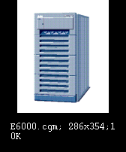

HTTP Connection
A connection is opened
Request Information
Provide Information
A connection is closed
HTTP Connection
(request-response exchange )
Yang Liu

Slide 45
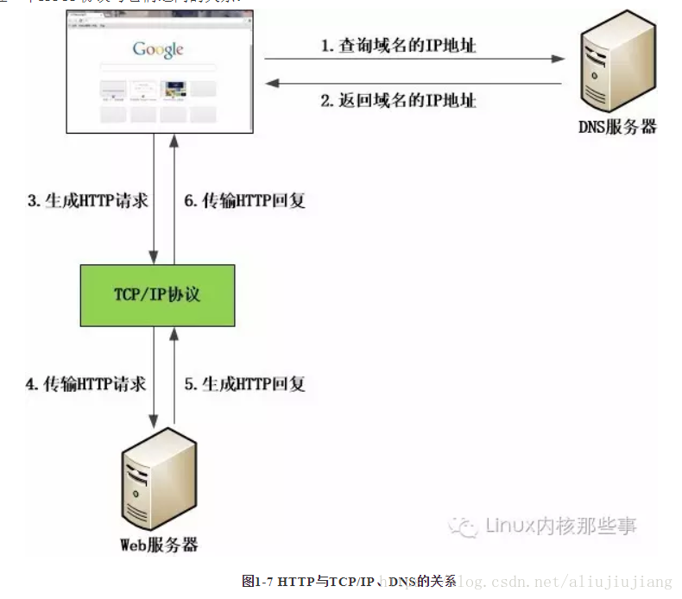
Protocols for HTTP Connection
Yang Liu

Slide 46
Sessions
User sessions
  Series of interactions a user has with a server to carry out a user task.
  The user session begins when the user first accesses the server through an initial HTTP connection, and the session ends when the user either completes or cancels the task
Yang Liu

Slide 47
Cookies
There are many situations in which a server must not only keep track of information from one transaction to the next, but also keep track of which client the information came from.
To keep track of these details, servers drop cookies into the client browsers.
Yang Liu

Slide 48
Cookies
Cookies
  A cookie is a piece of data generated by a web server and stored on the browser's computer for future reference.
  Cookies allow servers to "remember" information from one transaction to the next and to distinguish the requests that come from one client from the requests that come from other clients.
  Try to view the cookies that have been placed in your own browser.
Yang Liu

Slide 49
Server Push–Client Pull
Server Push
  Control of the client-server transaction is maintained directly by the server.
  The HTTP connection is left open, and the server sends data to the client any time it wants until either the server signals the end of the transaction or the transaction is interrupted by the client
  Ex. Chat room
Yang Liu

Slide 50
Server Push–Client Pull
Client Pull
  Requests are generated automatically, without user action, at specified intervals.
  The HTTP connection life cycle follows the pattern typical of client-server transactions initiated by user action.
  With client pull, HTTP response headers, whether generated by an application like a servlet or by HTML tags, direct the browser to retrieve either the same page or another page after a specified interval of time.
Yang Liu

Slide 51
Refresh
In client pull model
  With the application-generated-response-header approach to implementing client pull, the information directing the client to retrieve a page at a specified interval is inserted into the response as a header by an application, such as a servlet.
  Client pull can be implemented with information provided by an HTML document using the HTML META element.
Yang Liu

Slide 52
Client-Pull Demos
Ex.
  Simple Client Pull Demo
  SimpleSample.html
  Client Pull Animation
Yang Liu

Slide 53
META
META element provides a means by which an author can specify information about an HTML document.
META elements are enclosed by <HEAD> and </HEAD>.
When HTTP servers serve the document, they read its META elements and create HTTP response headers for all items defined by an http-equiv attributes and assigned values with accompanying content attributes.
Yang Liu

Slide 54
META
META has two attributes:
  name
  http-equiv
Yang Liu

Slide 55
META attribute--Name
<meta name=”parameter ” content= ”value”>
parameters
  keyword
  <meta name =‘keywords’ content=‘science, education’>
  description
  <meta name=‘description’ content=‘This page is about my life. ’>
  robots
  <meta name=‘robots’ content=‘all’ >
  author
  <meta name=‘author’ content = ‘name@163.com’>
Yang Liu

Slide 56
META attribute—http-equiv
<meta http-equiv = ”parameter” content=“value”>
<meta http-equiv="Content-Type" content="text/html; charset=gb2312">
<meta http-equiv="refresh" content="4; url=IsADynamicPage.html">
parameters
  Expires
  Refresh
  Published
  Pragam
  Set-Cookie
  Window-Target
  Content-Type
Yang Liu

Slide 57
Note
Not all browsers support http-equiv initiated refresh.
  If you use this technique to redirect traffic to another page, be sure to include a link to the new page on the page doing the redirect.
Some browsers, if they are busy when the time for the redirect arrives, may fail to execute the redirect.
  It is important to set the length of the interval long enough to allow the page to load completely over the slowest connection your users might be expected to use.
Yang Liu

Slide 58
1.3.3 Using Forms with Servlets
Form Submission and Servlets
The WelcomeForm Example
A Hands-On Example —
The PersonalWelcomeForm
Yang Liu

Slide 59
Form Submission and Servlets
What happen when forms are submit ?
How do forms send data to specific processing agents, such as servlets ?
Yang Liu

Slide 60
Forms and Servlets
The process of sending forms to servers and then to servlets consists of four steps
  All successful controls are identified.
  A form data set is built of control name—value pairs.
  The form data set is encoded.
  The form data set is sent to a server addressed to a servlet or other processing agent.
Yang Liu

Slide 61
First Step
This process begins with the activation of a form submit button.
The process identifies all successful controls—that is, all controls with current values that are valid for submitting to a server.
  In general, these include all controls that have initial values set with their value attributes or have valid current values as a result of actions occurring after the form was loaded.
  Exceptions to this are radio buttons and checkbox controls. To be successful, radio buttons and checkbox controls must 1) be "checked" and 2) must have initial values that are assigned with value attributes.
Yang Liu

Slide 62
Second & Third Steps
Once all successful controls are identified, the browser builds the form data set.
  This data set consists of the name-value pairs of all successful controls.
Once this data set of name-value pairs is assembled, the set is encoded .
Yang Liu

Slide 63
Fourth Step
The way the data set is sent to the server and the agent to which it is sent are determined by a FORM element's action and method attributes.
The action attribute identifies the agent (such as a servlet) by name and its location on the server, relative to the server's root directory.
The method attribute identifies the protocol by which the data set is to be sent.
  post is used for transactions that involve large amounts of data or when security is a requirement.
  get is used for transactions that do not involve a large amount of data and when security is not a requirement.
Yang Liu

Slide 64
Examples
Ex.
  http://www.google.com
Yang Liu

Slide 65
The WelcomeForm Example
WelcomeForm.html
How to use Workbench
About alias "/servlet/"
Yang Liu

Slide 66
A Hands-On Example
The PersonalWelcomeForm
Yang Liu

Slide 67
Thank you ！
Yang Liu

